Slide 1
Display Builder Web Runtime
Kay Kasemir
July 2026

Slide 2
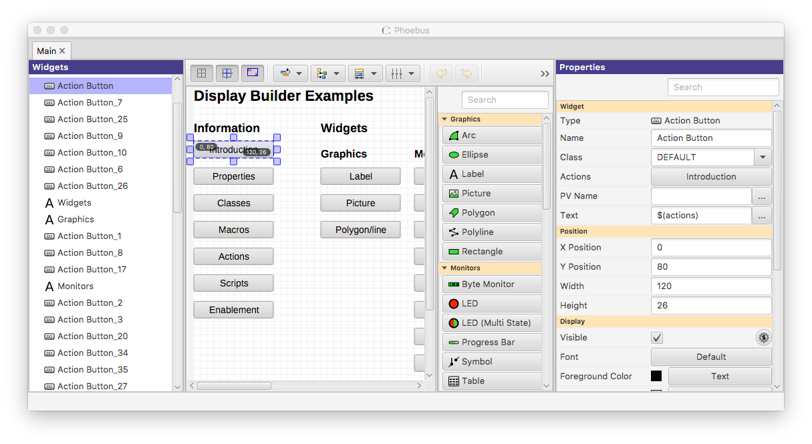
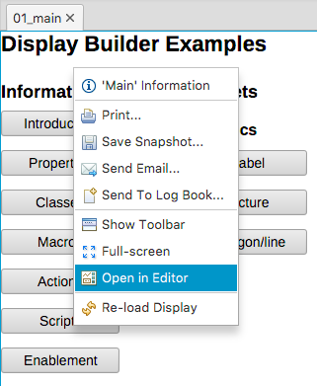
Display Builder in CS-Studio Desktop Tool
Best support for all widget types and their features
Includes editor for creating / modifying displays
But: Users need to install the tool, somehow access the display files, and the PV data (Channel Access, PV Access)

Slide 3
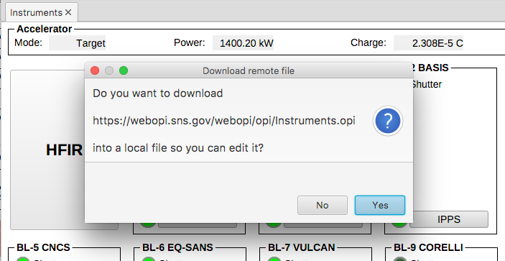
Storing Display Files on Web Server
Useful to make files available outside of control room
Safe, read-only, always up to date
.. But still using desktop tool.
To edit, you’ll be prompted for download

Slide 4
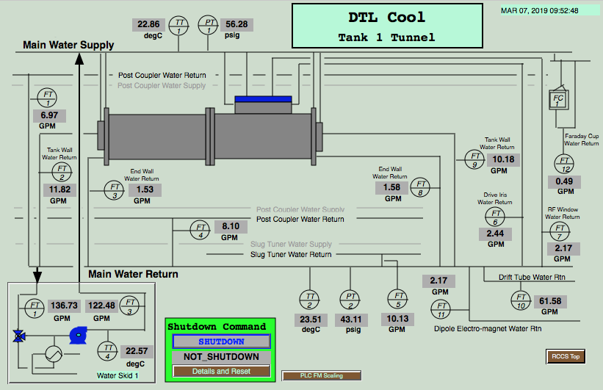
Display Builder Web Runtime
Client only needs web browser!
Some EPICS Display
Web Server (Tomcat)
Magic
Html, css, JavaScript
Metadata, then value updates
PV Web Socket
Ctrl System
At runtime,
network traffic similar to
{
pv: "SomePV",
value: 3.14
}

Slide 5
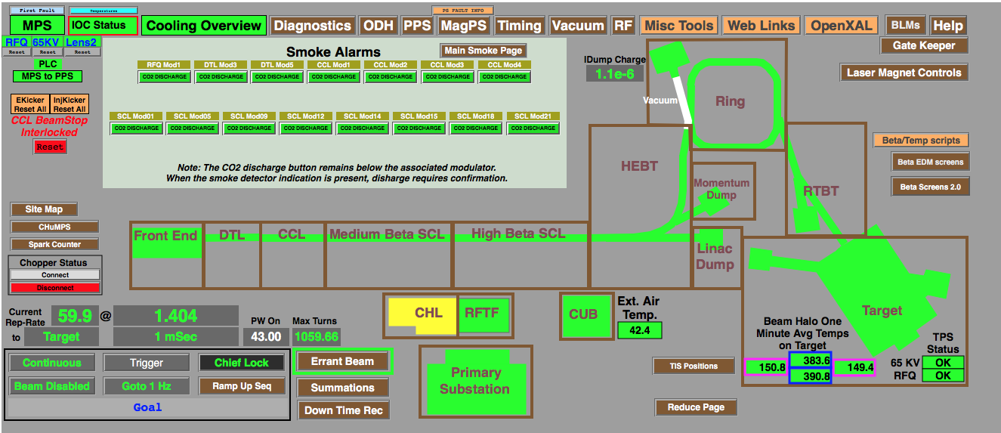
Web EDM
Ryan Slominski,
JLab,
2017 EPICS Meeting
Very useful and performant
for EDM displays
and Channel Access IOCs
Limitations:
No waveforms (plots, images)

Slide 6
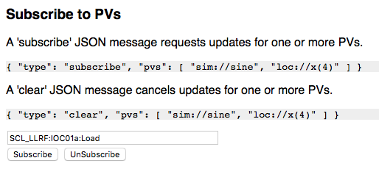
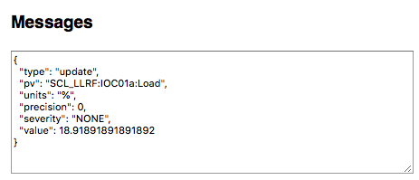
PV Web Socket - http://localhost:8080/pvws
Based on Phoebus Stack
  VType PV for loc://, sim://, ca://, pva://, …
  PV Pooling
  RXJava Throttling
Data Packaged as JSON
  Sends metadata once
    No separate connections to *.EGU, *.PREC, …
  Severity and value on change
  Arrays packed as Base64-binary
  JavaScript in client merges updates

Slide 7
Display Builder Web Runtime - http://localhost:8080/dbwr
Labels, LEDs, Text Updates
Groups, Embedded displays, Macros

Slide 8
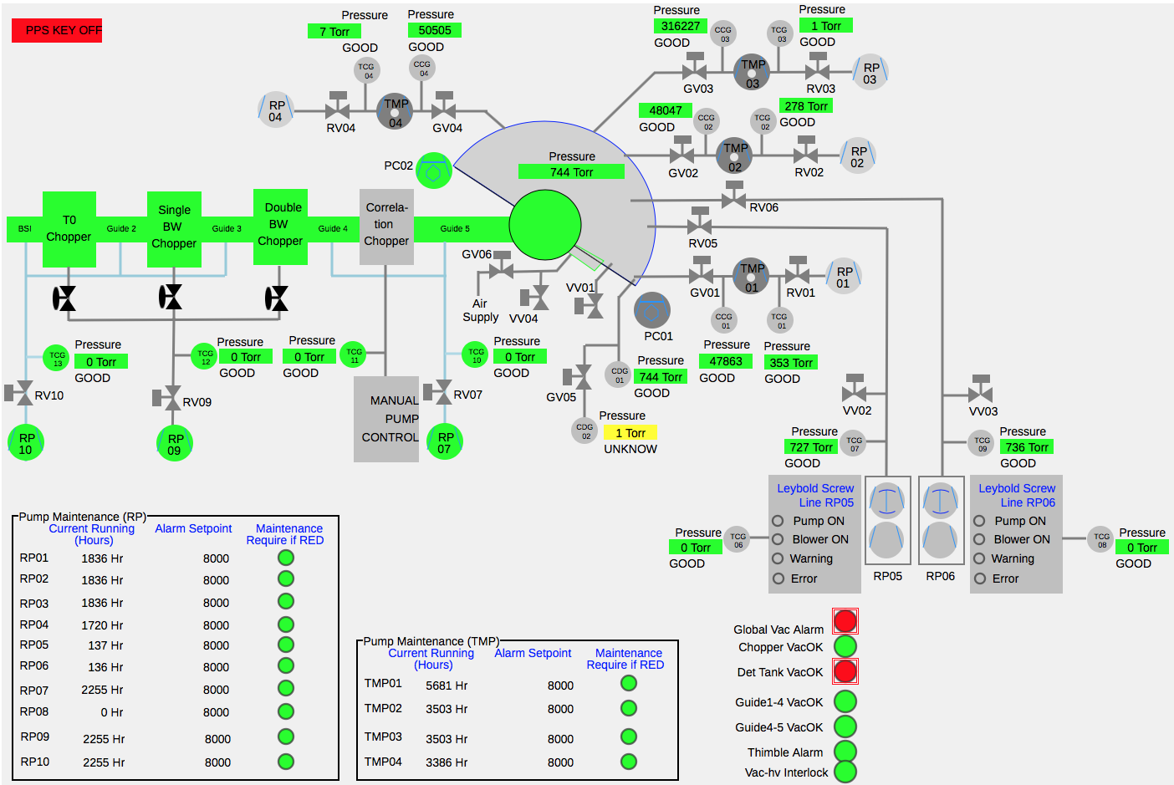
'Static’ Widgets
Lines,
Circles,
Rectangles, ..
Limited ‘Rule’
Support:
Some colors,
Hide/Show

Slide 9
Line and Detector plots

Slide 10
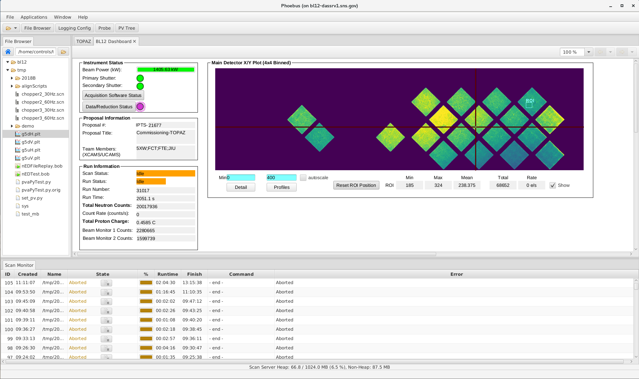
CS-Studio on Desktop vs. Web Runtime
Integrated Product
Widgets with full functionality
Just Display Runtime
Most widgets,
not full functionality
  Much simpler plots
You might have to tweak your displays to work for both desktop and web view…
Still:
Read-only web view of control system is extremely convenient and useful!

Slide 11
Summary
Display Builder Web Runtime offers web access to much of the
Desktop version
https://github.com/ornl-epics/pvws
https://github.com/ornl-epics/dbwr
git clone
ant
copy *.war to Tomcat
Set environment:
EPICS_CA_ADDR_LIST, ..
➔ http://your_site/dbwr

